Slide 1

“Let us meditate for a minute on James Bond. Clever and tough as he is, he’d be mincemeat a hundred times over if not for the hyper-competent support team that stands behind him. When he needs to chase a villain, the team summons an Aston Martin DB5. When he’s poisoned by a beautiful woman with dubious connections, the team offers the antidote in a spring-loaded, space-age infusion device…”
Erin Kissane, “A Checklist for Content Work”
Notes:
Think about Q, James Bond’s invisible other half. He is the person behind the success of Bond’s spy adventures. Q is essential to Bond’s work by providing him not only with the tools he needs but the resources and information he must have to use the tools effectively and all of this at precisely the time and in precisely the way that he needs them.
It does not talk down to him or waste his time. It anticipates his needs, but does not offer him everything he might ever need, all the time.
Similarly your job as a content developer is to provide your audience with the same considerations.

Slide 2
Web Content Development:
On Writing (Web Content) Well
Presented by
Milya Maxfield
The KSU Writing Center
Notes:
This presentation is composed of several parts. First, an overview of the the rhetorical triangle will illustrate the different components to take into consideration when writing content. Secondly, a breakdown of the three steps for writing content in relation to the writing process, getting started, writing, and publishing/maintaining, with strategies for accomplishing each step. Finally, a brief introduction to how the KSU Writing Center can help you at any of these strategies and at any point in your writing process.
Additionally, I am conducting a brief study on whether presentations such as these about writing in the workplace are an effective way to reach and engage faculty and staff in our community in an effort to improve our offerings specifically for you. At the conclusion of the presentation, I will be distributing a brief survey, and I would be tremendously grateful if you could fill it out and return it to me. A cover letter is attached to each survey explaining in more depth what the purpose is, and please keep the top copy for your records. As you will read on the cover letter, no identifying information will be collected.
I am also a very informal speaker, and I appreciate any questions that you may have at any point in this presentation, so please interrupt me at any time with questions/comments.

Slide 3
What Have You Heard About Writing Web Content?
Use bulleted lists
Keep the number of clicks down to a minimum
The truth is that there are no true “rules” for writing content.
Notes:
That’s what makes it so difficult.
But you can do it! James Bond never turns down a mission, and neither should you.

Slide 4
What is content strategy?
Notes:
Content Strategy in so many words is a relatively new field. The need clearly exists for individuals who can communicate effectively in writing, especially in the chaos that is the internet, and content strategists come from all different backgrounds to fill this need. Often from different fields, they fall into the role as the need for this kind of position grows. How did you come into this field?

Slide 5
What is Content Strategy?
So if there are no rules, what is content strategy, and why should we use it?
“Content strategy plans for the creation, publication, and governance of useful, usable content… Content is appropriate for users when it helps them accomplish their goals.”
Kristina Halvorson, “The Discipline of Content Strategy”

Slide 6
Writing Web Content: Getting started
Notes:
Determining Web Content Needs.
Generating Web Content → then organize according to purpose, audience, context

Slide 7
The Writing Process: Difficult Yet Effective
Brainstorming
Drafting
Revising
Editing
Publishing
Notes:
Walk audience briefly through the writing process.
Everyone has a different process

Slide 8

A Special Triangle
Message
Writer
Audience
Notes:
Aristotle is credited with creating the Rhetorical triangle for oral communication (because of the culture at the time).
It’s an effective way of starting to write too.

Slide 9
A Special Triangle: James Bond Style
Message:
Gadgets/Devices
Writer:
Q
Audience:
James Bond
Notes:
For the purposes of this presentation, we can define these presentations

Slide 10
Using the Triangle
Message:
What information are you communicating?
Writer:
What is your role?
Audience:
Who are you writing to?
Notes:
Make sure you consider these for every piece of content that you write. For example, your message will likely always change, and your audience could vary from page to page.

Slide 11
Refining the Triangle
Message:
How to request or acquire devices or gadgets for future missions
Writer:
Director of the
Department of Requisitions
and Acquisitions
Audience:
Agents who are
scheduled to begin missions
within the next two weeks

Slide 12
The Rhetorical Hexagram
Message
Tone
Style
Writer
Audience
Purpose
Notes:
And now we’ve switched to the rhetorical hexagram.
Three additional elements to consider.
Remember that if you have any trouble determining any of these, you can always rely on the elements on either side. For example, if you are having a tough time determining what style you should use, the best approach would be to consider ”audience” and “message.”

Slide 13
Using the Hexagram
Message
Tone
Style
How should your
message come
across?
What is the clearest, most
concise way to get the message
across?
Writer
Audience
Purpose
Why are you communicating this message?

Slide 14
Refining Hexagram
Message
Tone
Style
Formal but
accessible
3rd person
PDF forms followed by
explanations for their use
Writer
Audience
Purpose
Providing agents with a means to quickly
and efficiently request devices and gadgets for missions

Slide 15
Strategies for mission accomplishment
Notes:
So, now that I’ve introduced the situation around which you should set up for writing your content, let’s talk about ways to actually put this into practice.

Slide 16
Good Content is Appropriate
Q / James Bond
Even before Q starts tinkering with the Aston Martin or Bond’s vodka martini mix (shaken, not stirred), Q must anticipate what tools an agent will need and the best way to deliver them.
Webmaster / Audience
Good content strategists are in tune with their audiences’ needs and wants. Though you can never anticipate everything for every user every time, doing research and taking time to plan will ultimately make writing web content easier.
Notes:
What does “appropriate” web content look like? It actually has everything to do with what we just discussed.

Slide 17
Good Content is Appropriate: Strategy
Consideration | Question | Answer
Writer | What is your role?
Message | What information are you communicating?
Audience | Who are you writing to?
Tone | How should your message come across?
Style | What is the clearest, most concise way to communicate your message?
Purpose | Why are you communicating your message? Why is it important?

Slide 18
Good Content is User-Centered
Q / James Bond
Q would never dream of sending James Bond out into the field with devices that hadn’t been tested (many times) by other agents or Q himself.
Webmaster / Audience
Making sure your content is effective means testing its efficacy on the users who will be using it.
Notes:
What does it mean for content for content to be “user-centered?”
Skip mission statements, “About” pages, and press releases unless they are directly appropriate for your users.
Same with social media: do you need a snapchat, an Instagram, and a YouTube channel?

Slide 19
Good Content is User-Centered: Strategy
Conduct an Informal Usability Test
Ask a participant to complete a task on your website while you observe. Seeing a member of your audience navigate your content in person can help you troubleshoot problems you didn’t even realize you had.
Notes:
Check regulations for IRB (especially if you plan on making public or publishing any part of these tests)
What does asking good questions mean?
How can you conduct a basic usability test? (Give a task and either record or observe)

Slide 20
writing Web Content: Creating and revising

Slide 21
Good Content is Consistent
Q / James Bond
Once a device works for Bond, it must always work in the same way. Having one lever in the car signify torpedoes and the same lever in an identical car be a jettison device would have disastrous results.
Webmaster / Audience
Keeping content consistent gives your audience the ability to understand your message independently and effectively.
Notes:
How can you make sure content is consistent?
It does mean that if you call something a “enrolled student” in one place, you definitely can’t call it a “degree-seeking student in another place. Though they may mean the same thing to you, your audience may be looking for a nuanced difference between the two.
Consistent content does not mean stagnant content. It does mean taking the guesswork out of finding information.

Slide 22
Good Content is Consistent: Strategy
Create an in-house style sheet. When building a style sheet, consider
Commonly used terms
Organizational structures
Defined headings
Notes:
What is that? And doesn’t OMNIUpdate already give us a consistent, rigid template to use?
A style sheet for your organization might mean specifying in which instances you spell out “Science Technology Engineering Math” and when you just use the acronym “STEM.”
You may also choose to use a commonly used style guide as your default, for example, the Chicago Manual of Style, (I would recommend this), but it’s not a substitute for what your organization needs specifically.
Will something be a L1 or an L2? (Goes beyond just bullet points)

Slide 23
Good Content is Clear and Concise
Q / James Bond
Q never makes Bond read through an instruction manual before he can use the devices; they are intuitive.
Webmaster / Audience
Clear and concise writing improves readability and increases the chances that your audience will understand the message.
Notes:
How can you make sure content is clear and concise? Do you have any strategies?
Revision and editing

Slide 24
Good Content is Clear and Concise: Strategy
Organizational Structure
Sentence Structure
Known/New
Short vs. Long Sentences
Paramedic Method
Notes:
Organization has to make sense to your user (not just to you).
Sentence Structure and Variation
Known/New information
Short vs. Long Sentences
Does anyone know the difference between revision and editing?
Things to consider when revising
Things to consider

Slide 25
Writing Web Content: Maintaining

Slide 26
Good Content is Supported
Q / James Bond
Bond has the luxury of walking away from a case once it’s closed. Unfortunately, Q and his team don’t have the same luxury. He must continuously work in the background, repairing damaged devices, updating and maintaining tools, and always being ready to create new ones when the demand arises.
Webmaster / Audience
Finished content requires the work and dedication of a team to ensure that content is ready to publish initially and reviewed periodically to update the content for accuracy.

Slide 27
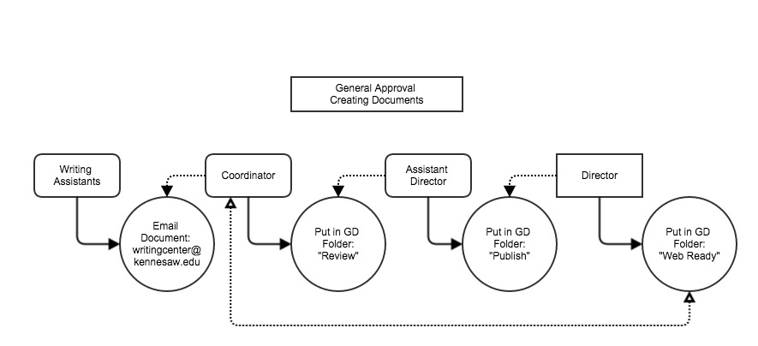
Good Content is Supported: Strategy
Create an Editing Chain
Notes:
Google Drive

Slide 28
How can we Help?

Slide 29
The KSU Writing Center Offers
One-on-one sessions with writing assistants for students, faculty, and staff (including all of you!)
Help at any stage of this process – coming up with ideas, making your content concise, and working with you on editing.
Online resources with information about common writing issues.
Staff Drop-In Hour every other week.

Slide 30
Bibliography
Halvorson, K. () The discipline of content strategy. Retrieved from A List
Apart website: https://alistapart.com/article/thedisciplineofcontentstrategy
Kissane, E. (2011, Mar 8) A checklist for content. Retreived from A List Apart website: https://alistapart.com/article/a-checklist-for-content-work
Purdue Online Writing Lab. Paramedic method: A lesson in writing concisely. Retrieved from website: https://owl.english.purdue.edu/owl/resource/635/01/
Williams, J. M. (2000) Style: Ten lessons in clarity and grace. New York, USA: Longman..

